Slide 1

MY N3tWORK STORE
St. Francis Institute of Technology
Department of Computer Engineering
Group Members
.
Name | Roll No.
Yogita Likhi | 46
Sherwin Mathias | 53
Ujala Maurya | 54
Nithin Menezes | 58

Slide 2

Content
Introduction
Problem Statement
Implementation
Output
Conclusion

Slide 3
Problem Statement
Develop an android app for a Networking Components Store. The app should have an interactive GUI. The app should use the database for saving, updating and deleting the orders. The app should also make use of GPS and notification to provide the user with his/her current address and location.

Slide 4
Implementation
We used Java for programming for our app.
Our project is divided into three modules:
The Main module – It displays the main Home page of our app
The Item Detail module – It displays the page for a given item where the user orders the item.
The Order module – It displays the orders placed by the user in the past.

Slide 5
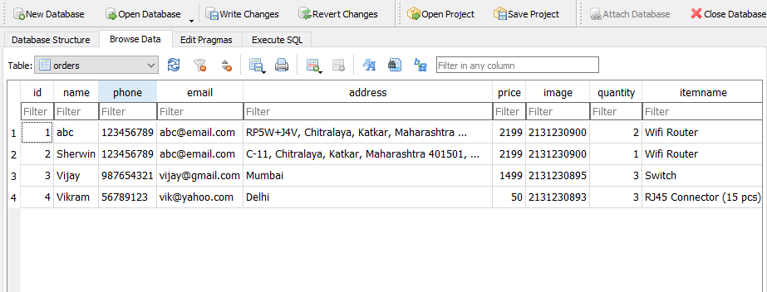
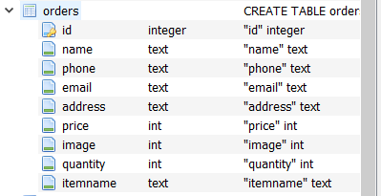
Implementation
For the database functionality, we have used SQL.
Our database looks like this:

Slide 6
Implementation
User-friendly UI/UX:
The layout of the app is designed in such a way that it is interactive as well as simple and easy to use. The user will never feel lost while using our app.
In case of situations like ordering or updating the order, a toast notification will be displayed. Also in case of some situations like deleting the order or exiting the app, an alert prompt will be displayed before carrying out the action.
Database functionality:
A database is created for the app which saves and stores the orders of the user. The user can order, update as well as delete his orders in a hassle-free way.
GPS & Notifications:
The user can be notified about their current location via a push notification.

Slide 7
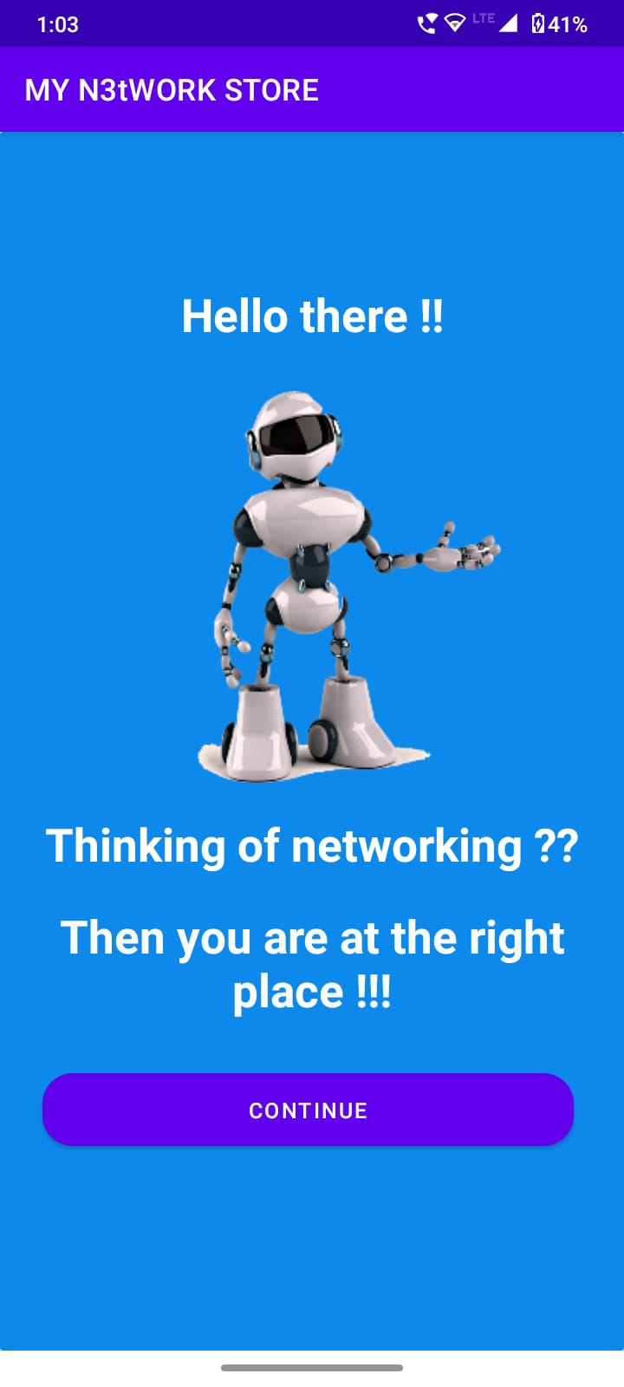
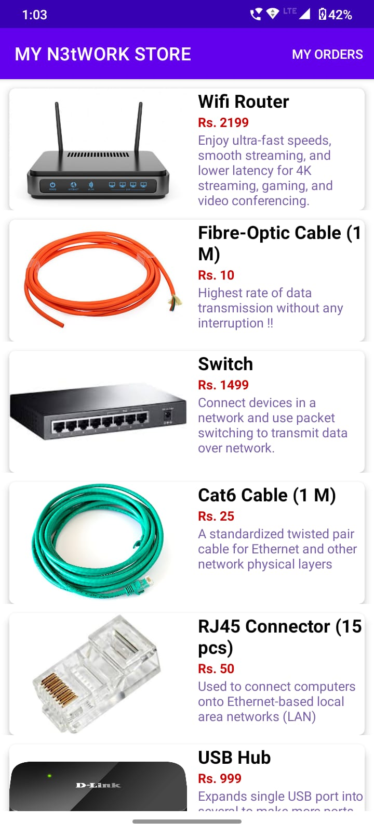
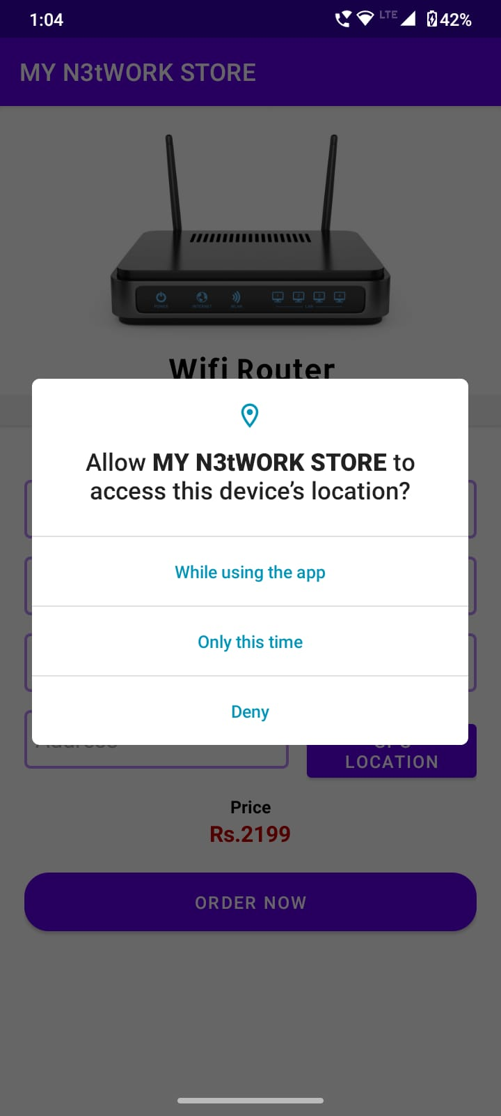
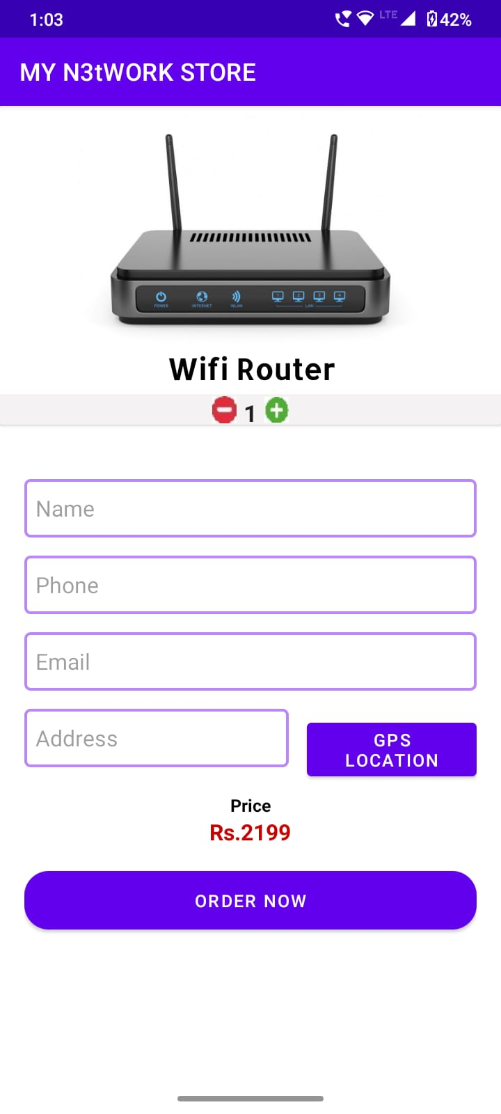
Output

Slide 8
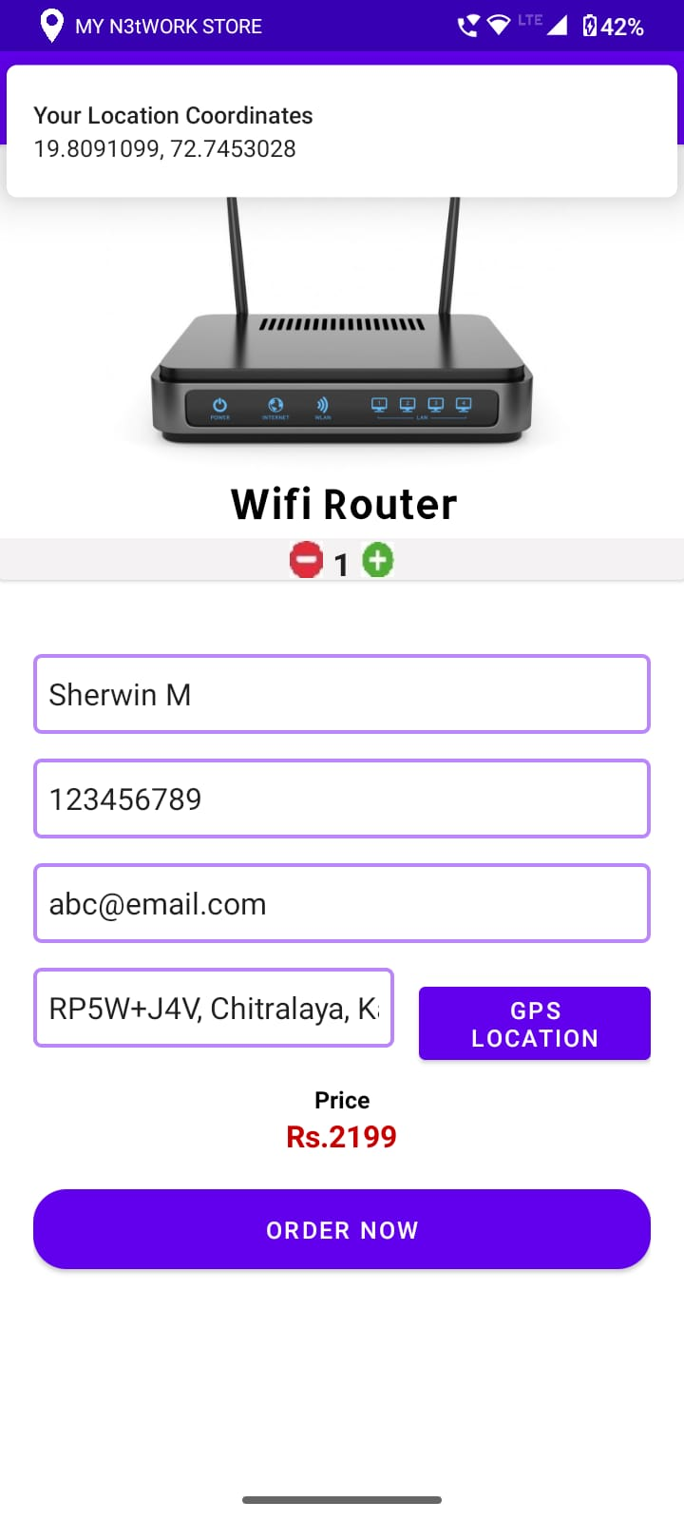
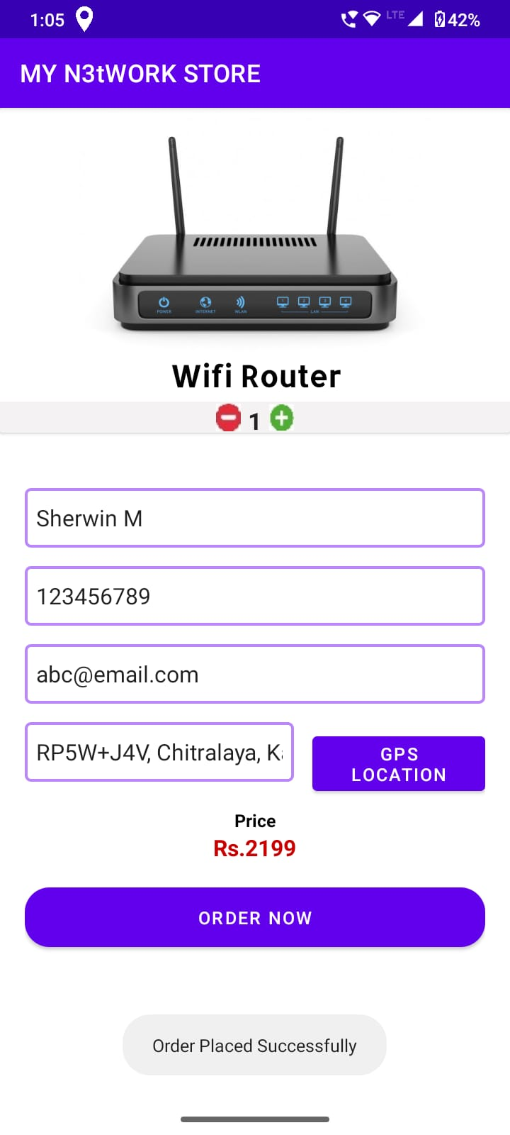
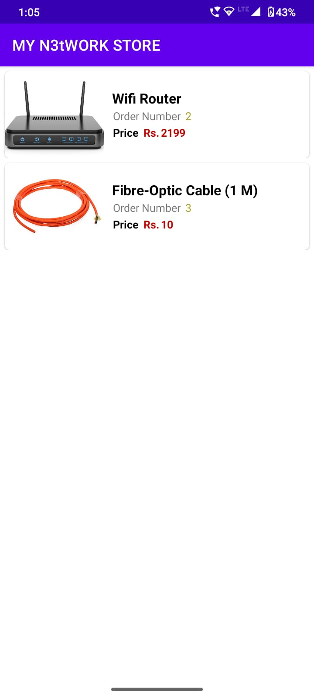
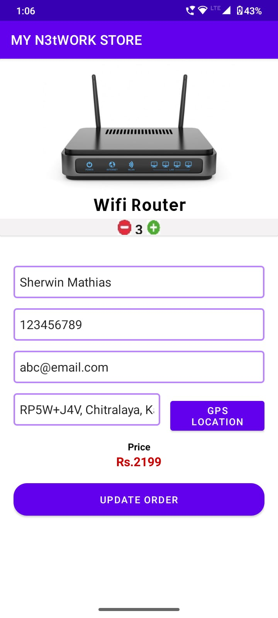
Output

Slide 9
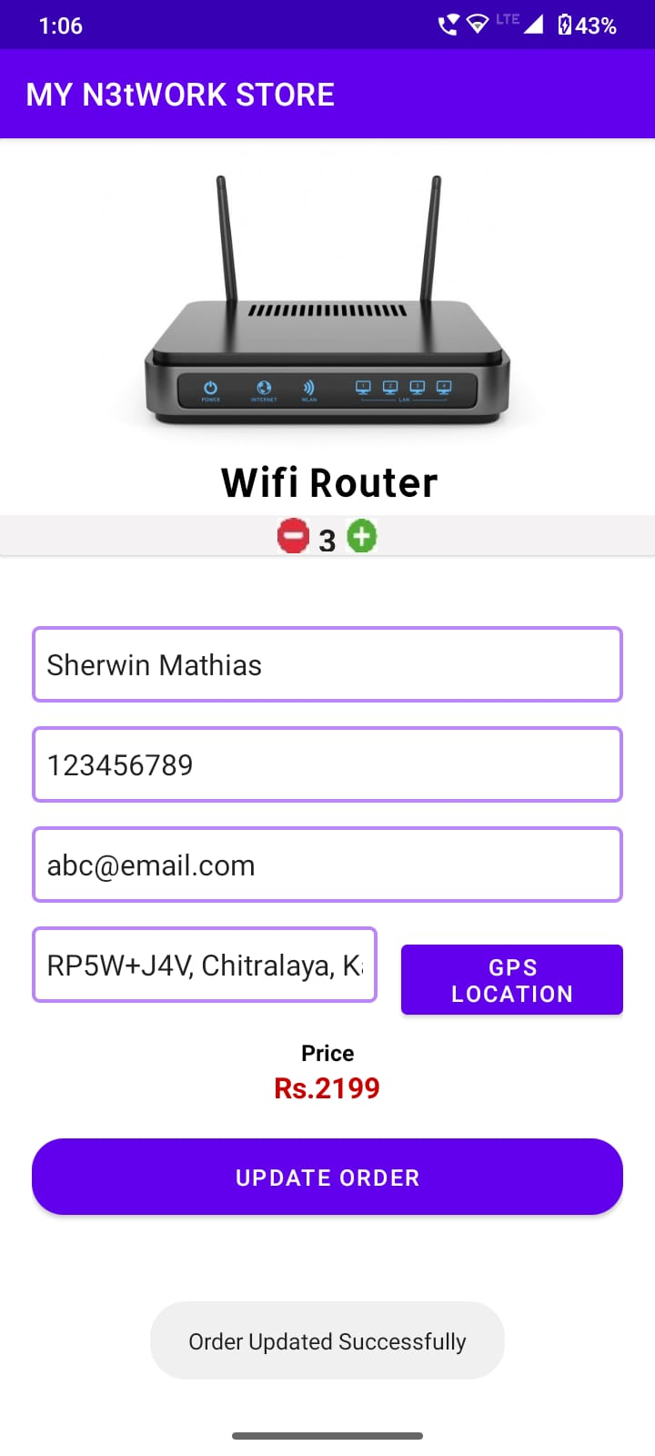
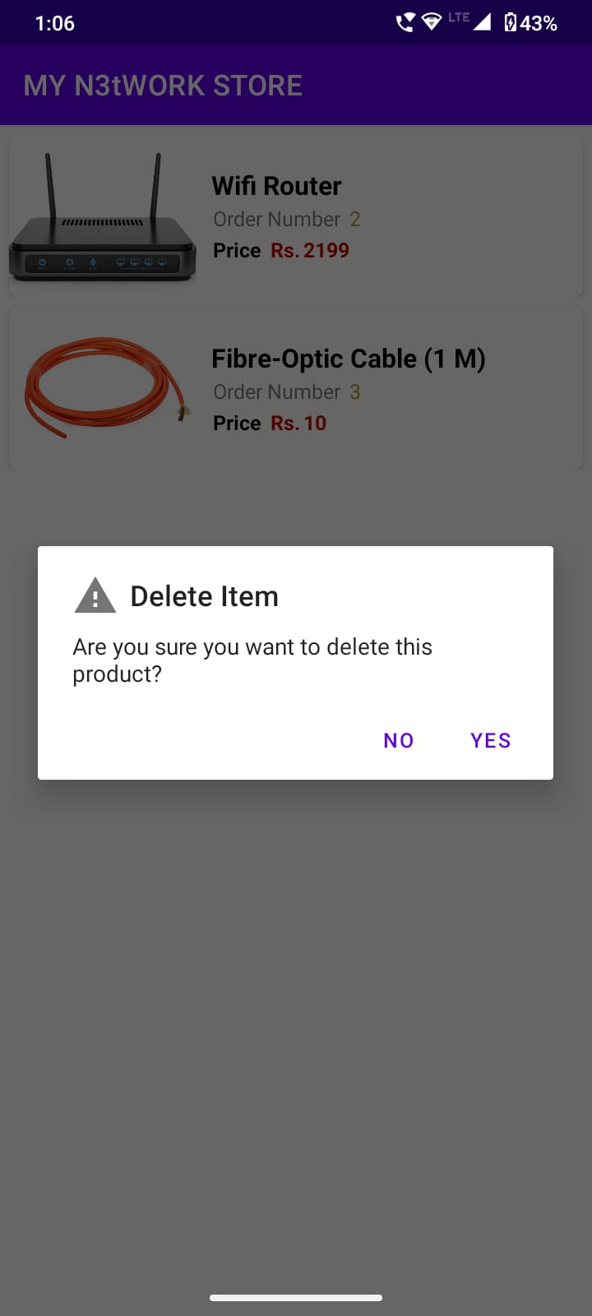
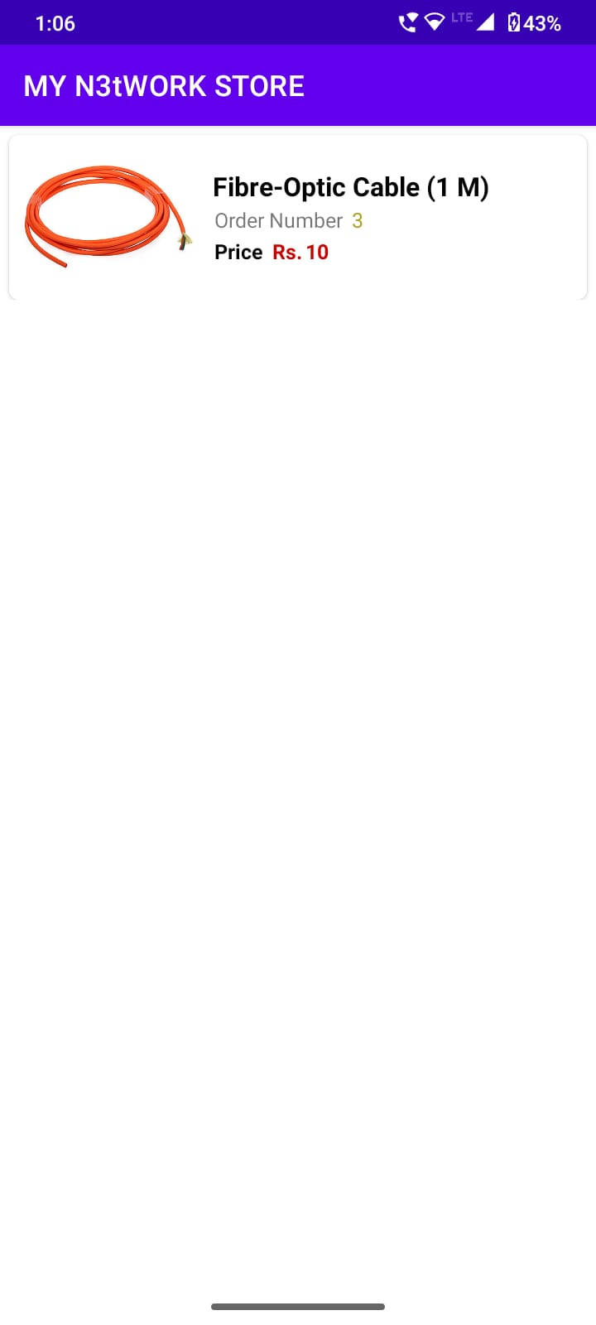
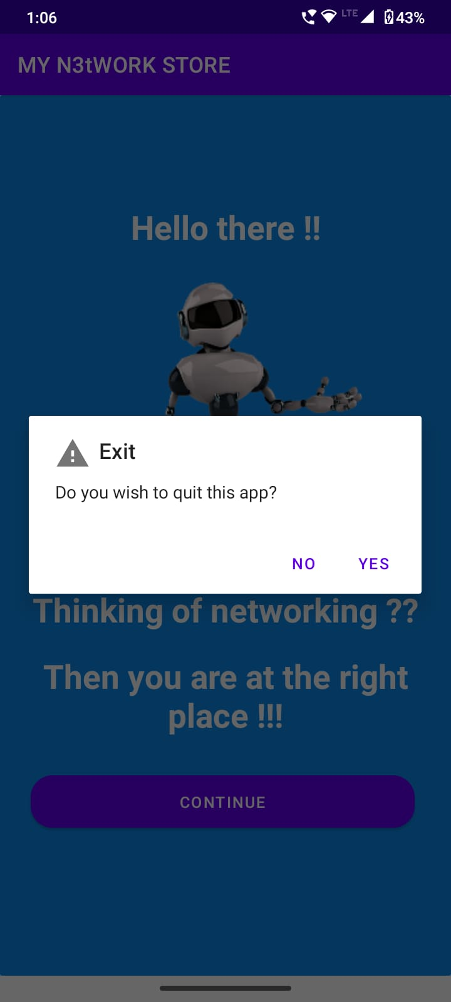
Output

Slide 10
Conclusion
Thus, we have successfully created a Networking Components Ordering app called My N3tWORK STORE keeping in mind all the important points mentioned in the Problem Statement like an interactive app with good GUI, usage of Database for Saving, Deleting and Updating the orders, Usage of GPS and notification for showing the user his/her current address and location.
We also provided some additional features like alerts while the user deletes his orders or exits the app.
Using our app, the user will be able to buy any networking component which he wants for his use.
Notes:
Maximum of two slides.

